Slide 1

PRESENTED BY Group 1 PGDM 2022-2024 Orijita Adhikary Pratyay Ghatak Ritwik Saha Sayan Sinha
COMPARISON OF ANXIETY LEVELS AMONG MALE AND FEMALE STUDENTS DURING COVID-19 LOCKDOWN

Slide 2
Objective
The basic intention of this project is to figure out the different levels of anxiety among the male and female students in the changing scenario of the pandemic.
Generalized Anxiety Disorder (GAD) – It is a psychiatric disorder characterized by a constant sense of worry and fear that interferes with daily life. People with Generalized Anxiety Disorder may experience feelings of dread, distress, or agitation for no discernible reason.
GAD-7 Scale – It is a self-report measure of anxiety. The scale consists of seven items, each of which measures a different aspect of anxiety symptoms. These items are worry, tension, restlessness, muscle pain, fatigue, difficulty concentrating, and irritability
Westside Anxiety Scale-The Westside Test Anxiety Scale is a brief, ten item instrument designed to identify students with anxiety impairments who could benefit from an anxiety reduction intervention.

Slide 3
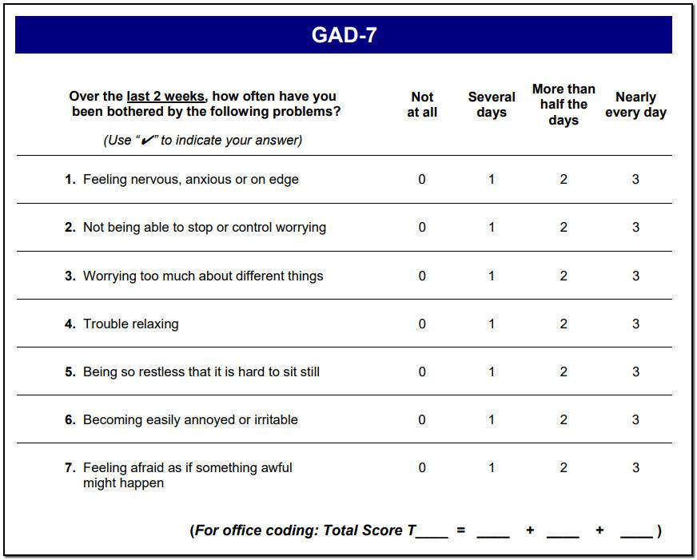
Data Source
Collected primary data using the standardised questionnaire of GAD 7 and Westside anxiety.
GAD 7 :
Calculated the total score for each individual.
Total question = 7
Max marks for each question = 3
Total Marks = 7*3 = 21
Obtained Marks = Sum of the marks obtained in all the 7 questions.
Depending on the score obtained it has been ranged in the table below:
GAD Score | Severity of anxiety
0-4 =1 | No/little Anxiety
5-9=2 | Mild Anxiety
10-14=3 | Moderate Anxiety
15-21=4 | Severe Anxiety

Slide 4
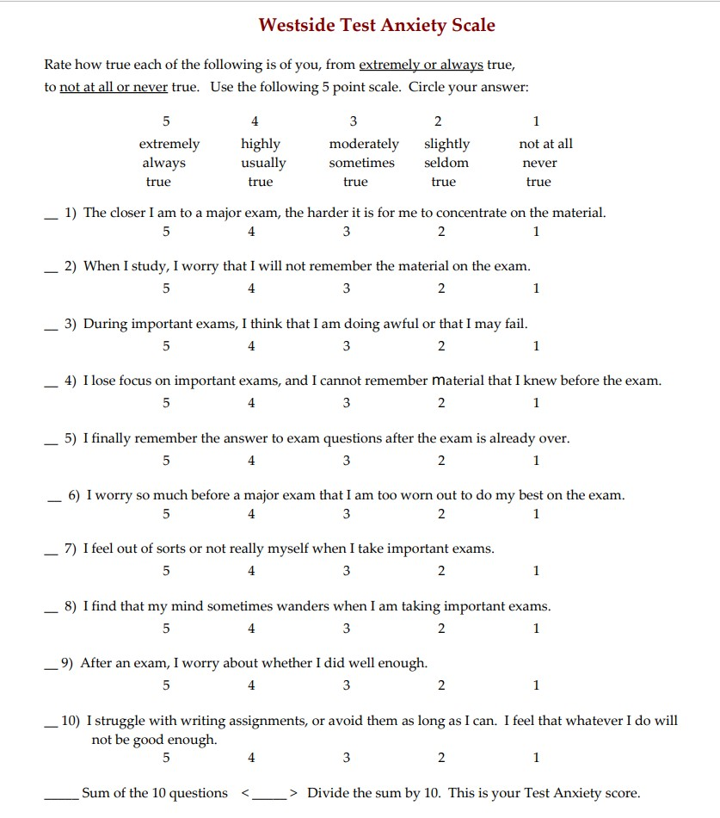
Westside Anxiety Scale :
Calculated the total score for each individual.
Total question = 10
Max marks for each question = 5
Total Marks = (10*5)/10 = 5
Obtained Marks = (Sum of the marks obtained in all the 10 questions)/10.
Depending on the score obtained it has been ranged in the table below:
Westside Anxiety Score | Severity of anxiety
1.0-1.9= 1 | low
2.0-2.5= 2 | normal
2.6-2.9=3 | normal high
3.0-3.4= 4 | moderately high
3.5-3.9= 5 | high
4.0-5.0= 6 | extremely high

Slide 5
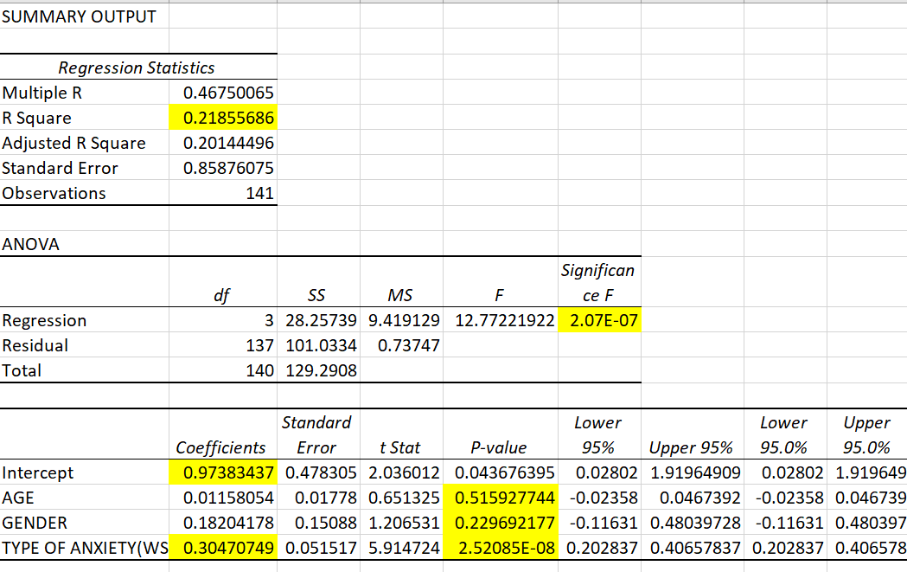
Multiple Regression
Objective – To find whether age , gender and westside anxiety score are responsible variables for GAD7 score or not.
Steps for regression:
Identifying the variables,
Independent Variables : Age, Gender, Westside Anxiety Score
Dependent Variable: GAD-7 Score
Performed multiple regression in excel.

Slide 6
Analysis and result of multiple regression
Regression Equation: y = 0.97 + 0.01x₁ + 0.18x₂ + 0.3x₃
R Square
R square = 0.219, that means that roughly about 22% of the variability in the GAD7 score can be explained by the entire set of independent variables that we have considered.
0.22 < 0.7 - Not a good model for prediction
Significance F
Significance F = 2.07E-07 which is < 0.05. This indicates that the model is statistically significant.
P- value
Age – (0.5 > 0.05) - no significant association between GAD-7 and age
Gender – (0.23 > 0.05) - no significant association between GAD-7 and gender
Westside Anxiety Score – (2.52085E-08 < 0.05) - significant association between GAD-7 and Westside anxiety score
Coefficients
For unit change in westside anxiety score there is 0.3 change in the score of GAD7

Slide 7
Interpretation of multiple regression
We cannot predict the GAD-7 anxiety score by knowing age and gender.
GAD 7 score have a significant association with Westside anxiety score.
Hypothesis Testing
T test
For T test we have divided the GAD 7 score with respect to gender.
Identified the null and the alternative hypothesis,
H0 : The average GAD 7 score in female <= The average GAD 7 score in male.
H1 : The average GAD 7 score in female > The average GAD 7 score in male.
Performed the test in excel.

Slide 8
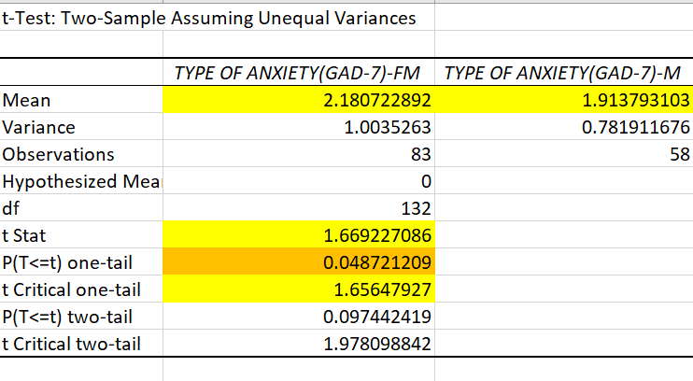
Analysis and results for T test
P value = 0.0487 which is < 0.05, so we reject the null hypothesis.
Also our calculated T stat is > critical T value which means we reject the null hypothesis. Hence, our alternative hypothesis is true.
Interpretation for T test :
The average GAD 7 score in female > The average GAD 7 score in male.

Slide 9
Chi Square Test
For chi square test we have created the observed table by calculating the count of people gender wise for different GAD 7 indexes and Westside Anxiety indexes.
Identified the null and the alternative hypothesis for performing the two Chi Square Test,
For GAD 7
H0 : There is no association between gender and GAD 7 index
H1 : There is association between gender and GAD 7 index
For Westside Anxiety
H0 : There is no association between gender and Westside Anxiety index
H1 : There is association between gender and Westside Anxiety index
Created the expected table.
Calculated the p value by using ‘CHISQ.TEST()’ in excel.

Slide 10
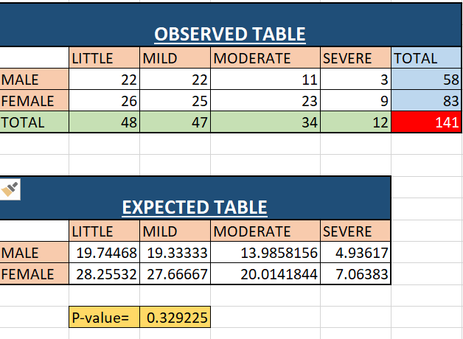
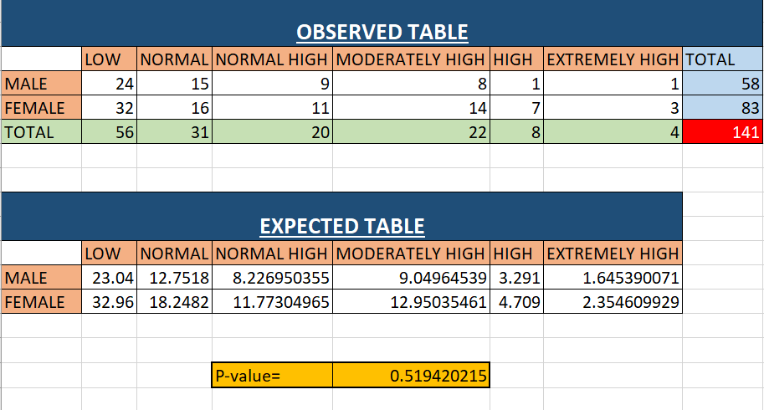
Analysis and results for Chi Square test
GAD 7
P value = 0.33 which is > 0.05, so we cannot reject the null hypothesis.
Westside Anxiety indexes
P value = 0.52 which is > 0.05, so we cannot reject the null hypothesis.
Interpretation:
GAD 7
There is no association between gender and GAD 7 index.
Westside Anxiety indexes
There is no association between gender and Westside Anxiety index.

Slide 11
Conclusion
From the above quantitative analysis it can be concluded that the research conducted to find out the level of anxiety in general among the male and female students was successfully administered and it can be finally concluded that,
We cannot predict the GAD-7 anxiety score by knowing age and gender. So we can conclude that Generalized Anxiety Disorder can occur at any age irrespective of their gender.
GAD 7 score have a significant association with Westside anxiety score. Hence we can say that those who are already suffering from normal anxiety have higher tendency to develop higher level of GAD.
Average GAD 7 score of female students is more than that of male students. From this we can say that female students have a higher tendency to suffer Generalized Anxiety Disorder.

Slide 12
THANK YOU

